Slide 1

TWINKIE, THE DOG
What do you know?
What do you wonder?
Thank you, Dan Meyer, for this “Three-Act Math” lesson: World Record Balloon Dog.
http://www.101qs.com/3933

Slide 2
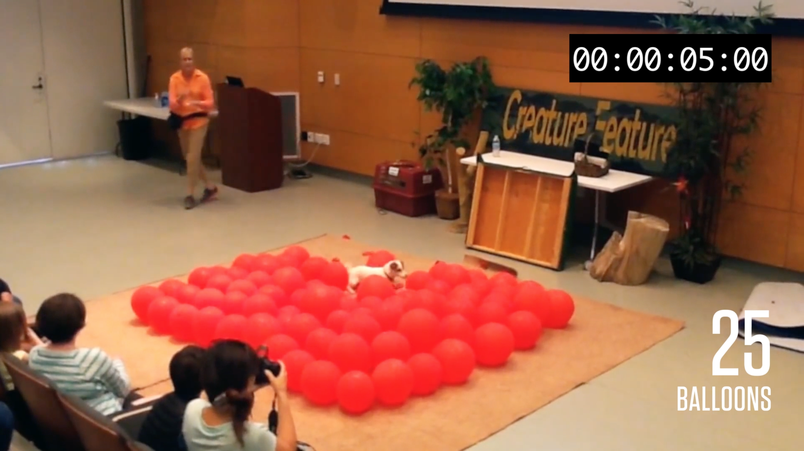
TWINKIE, THE DOG
(1) How long do you think it will take Twinkie to pop all the balloons? Explain or show your reasoning.

Slide 3
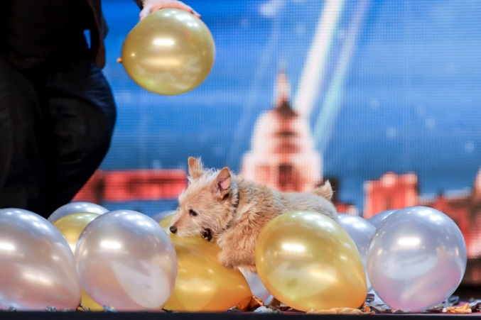
A WORLD RECORD HOLDER:
CALLY THE WONDERDOG
Another Jack Russell Terrier, Cally, completed the feat in an incredible 41.67 seconds on “Britains Got Talent” on May 15, 2015.
(2) Do you think Twinkie will break Cally’s record?
Do you think your mathematical answer is going to match the actual answer? Explain.
Do you want to adjust your mathematical answer up or down? If so, why?

Slide 4

TWINKIE, THE DOG
June 28, 2016
Did the result surprise you? If so, how?

Slide 5
A CLOSER LOOK AT THE DATA
(3) Use data from the video. Make a table. Find unit rates.
(4) Make a graph.
Time (sec) (x) | # of Balloons (y) | Unit Rate:
# of balloons
5 25 5
12 50 4.2
22 75 3.4
10
38 100 2.6
5
Time

Slide 6

PROPORTIONAL RELATIONSHIPS
Two variables are in a proportional relationship if:
The values of one are the same constant multiple of the values of the other.
The unit rates formed by pairs of values are equal.
A graph of the pairs of values fall on a line through the origin.
(5) Does the pace of Twinkie’s balloon breaking record represent a proportional relationship? Why?

